Slide 1
TRANSITS I
Operational Module
Authors: Olivier Caleff, Sven Gabriel, Przemyslaw Jaroszewski, Andreas Muehlemann, Roeland Reijers, Marius Urkis
Version: 7.1
This work is licensed under a Creative Commons Attribution-NonCommercial-ShareAlike 4.0 International License

Slide 2
HIDDEN SLIDE – MUST NOT BE PRESENTED OR PRINTED
IF YOU SEE THIS SLIDE WHEN PRESENTING THIS SLIDE DECK OR
IF YOU SEE THIS SLIDE WHEN CONVERTING THIS SLIDE DECK INTO PDF
OR IF YOU SEE THIS SLIDE WHEN PRINTING THIS SLIDE DECK
THEN STOP! THERE’S A PROBLEM

Slide 3
Session Plan
Section 1 – Introduction to Incident Management
Section 2 – Incident Handling – The ENISA Approach
Section 3 – Real World Challenges
CSIRT vs SOC
Roles
Governance Issues
Preparation: Default rules, Resilience
On-Site and Off-Site Incident Handling
Section 4 – Data Acquisition & Threat Intelligence
Detection, Monitoring, Reporting
Section 5 – Secure communications (Messaging, PGP and TLP)
Section 6 – Wrap-up
Notes:
Purpose to manage expectations
What will happen, when & how
Could be important to think about
Working in groups or pairs
Non-participation
Interactions that is a balance of trainer delivery & Trainee input

Slide 4

Exercise #1 – Fire Alarm
Photo by Joshua Newton on Unsplash
Notes:
Trainer Notes: You can do this exercise either in a discussion or in a live exercise. Be aware of venue rules on spilling water…
Goal of this exercise:
Scenario:
We have a fire in a container at the other end of the room
We've got bottles of water, glasses
We have to stop the fire!
Action:
Let's do something
Let's pour water in the container
Rules:
Rule #1: we can't bring bottles of water, we have to carry glasses
Rule #2: no more than 5 minutes (sharp) for the exercise
Rule #3: you can panic!
What worked?
What failed?
Next time, what would you do?
Name some incident-oriented jobs
Firemen are NOT mighty lonesome gurus who can solve ANY fire no matter its size, location, and "combustible"
Understand that it's a TEAM effort, each and everyone cooperating in reaching "a" solution
→ 1 + 1 > 2
Follow the process rather than creating new ways to solve bleeding edge issues
→ Preparation is key
Message of the day:
Don't reinvent the wheel,
Follow the rules and operations will run smoother and far better

Slide 5
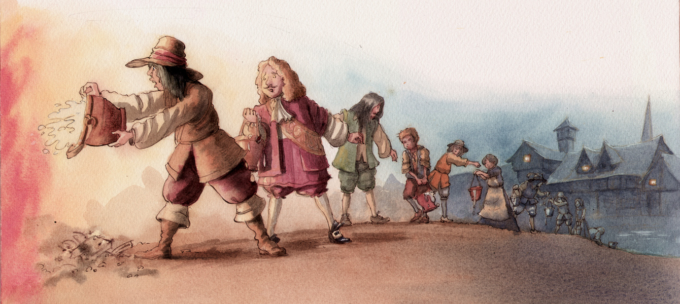
Exercise #1 – Fire Alarm
Notes:
Trainer Notes: You can do this exercise either in a discussion or in a live exercise. Be aware of venue rules on spilling water…
Goal of this exercise:
Scenario:
We have a fire in a container at the other end of the room
We've got bottles of water, glasses
We have to stop the fire!
Action:
Let's do something
Let's pour water in the container
Rules:
Rule #1: we can't bring bottles of water, we have to carry glasses
Rule #2: no more than 5 minutes (sharp) for the exercise
Rule #3: you can panic!
What worked?
What failed?
Next time, what would you do?
Name some incident-oriented jobs
Firemen are NOT mighty lonesome gurus who can solve ANY fire no matter its size, location, and "combustible"
Understand that it's a TEAM effort, each and everyone cooperating in reaching "a" solution
→ 1 + 1 > 2
Follow the process rather than creating new ways to solve bleeding edge issues
→ Preparation is key
Message of the day:
Don't reinvent the wheel,
Follow the rules and operations will run smoother and far better

Slide 6
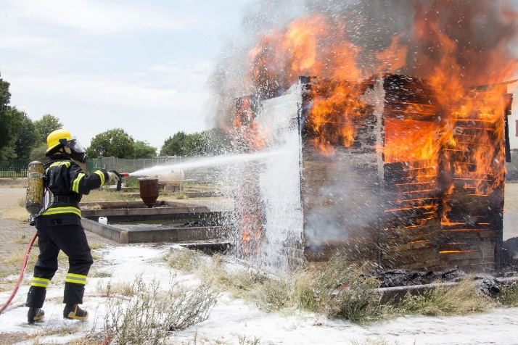
Exercise #1 – Short Debrief
What worked?
What failed?
Next time, what would you do? What would you change?
Other incident-oriented jobs?
Fire-Fighting
The History of Fire Fighting → http://www.emergencydispatch.org/articles/historyoffirefighting.html
Fighting Fire with Organization: Summing it all Up → http://www.netage.com/pub/books/TeamNet/CHAPTERS%20PDF/CHAPTE~3.pdf
Photo by Hush Naidoo on Unsplash
Notes:
References – both for firefighting and CSIRT work.
Other incident-oriented jobs:
Hospital, Emergency Room
Police
Military
Sea Rescue
…
6

Slide 7

Exercise #1 – Short Debrief
Fireman are NOT mighty lonesome gurus who can solve ANY fire, no matter its size, location and “combustible”
Understand that it's a TEAM effort, each and everyone cooperating in reaching ”a” solution → 1 + 1 > 2
Follow the process rather than creating new ways to solve bleeding edge issues → preparation is key
Message of the day:
Don't reinvent the wheel
Follow the rules and operations will run smoother and far better
Notes:
”combustible” – leicht entzündbar
It's a team effort, needs team organization
Prepare – follow your preparation – adapt where necessary
7

Slide 8
Section 1: Introduction to Incident Management
Olivier Caleff, Sven Gabriel, Przemyslaw Jaroszewski, Andreas Muehlemann, Roeland Reijers, Marius Urkis
_
_

Slide 9


Section 1: Group Discussion
What are your top 5 issues when it comes to handling incidents?
Photo by Mimi Thian on Unsplash

Slide 10

Section 1: Introduction to Incident Management Basic Terminology
Incident Handling
Incident Response
Incident Management
Crisis Management
Photo by Jon Tyson on Unsplash
Notes:
Trainer Notes: Let's define the different words first.
What is Incident Handling, Incident Response, Incident Management, Crisis Management
____

Slide 11

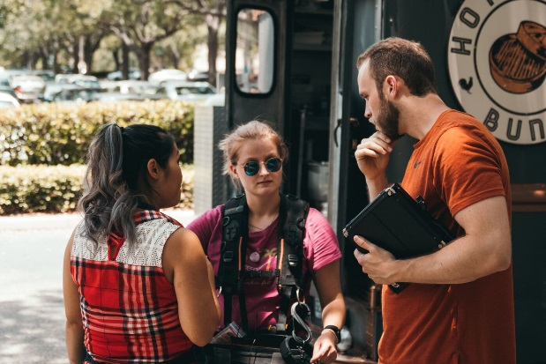
2. Incident Handling 1 – Incident Response versus Incident Handling
Complementary roles
Incident Response
Analysis and Containment
Incident Handling
Logistics and Communication
Planning and Coordination
Processes and Procedures
Different skill sets
The bigger the incident, the more complex it will be:
Organize the activities
Hands-on analysis and technical work requires a dedicated mind
Provide support to the Incident responder
Photos by Julian Hochgesang and Kal Visuals on Unsplash
Notes:
Let's start with IR and IH
Definition by SANS:
Incident response is just the technical resolution of the incident (hands on, command line, …)
Incident handling is much broaded activity which includes all the communication aspects, PR involvement, legal involvement, feedback loop, procedures, etc.

Slide 12

2. Incident Handling 2 – Incident Response versus Incident Handling
Real-time activities
Detection
Incident Handling
Incident Recovery
Investigation
Management
Legal
Communications
Off-line activities
Policy
Preparation
Procedures for incident information tracking, incident reporting and handling
Post-mortem
Photo by Neonbrand on Unsplash
Notes:
Real time activities during handling the incident
Off-line activities pre- and post incident, important to be done, but not during an incident, need often a 'clear' head

Slide 13
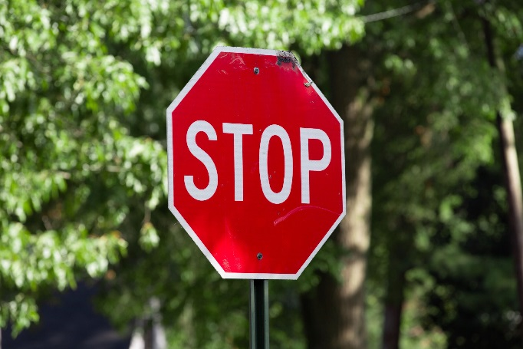
2. Incident Handling 3 – Passive vs. Active defense
Passive defense:
Firewalls
AV Solution
Blacklists
…
Active defense:
Adapting to the current threat
Adjusting filters upon analysis results
Active defense is NOT 'hacking back'
We act / react to the current threat
But we stay within the legal boundaries
Photo by Will Porada on Unsplash
Notes:
Passive: work alone, no adjustments needed
Active: adjust to the current threat
But: we don't hack back!

Slide 14

2. Incident Handling 4 – For smaller teams
Some incident handling teams are as little as 2 people
Simple tools for coordination and logging
No dimensioning issues
Excel spreadsheets, Wiki
Split between Incident Response and Incident Handling
IR: Technical matters
IH: taking care of the constituency/executive/management
Coordination
Even more important to protect Incident Responder(s) from everything else
Don't bother ”hands-on” staff
Remember fire-workers or police officers
Photo by David Von Diemar on Unsplash
Notes:
Smaller teams, not so easy but can still be effective
Keep the Incident Reponders' back free, Incident Manager is the single point of contact, keep room clear

Slide 15
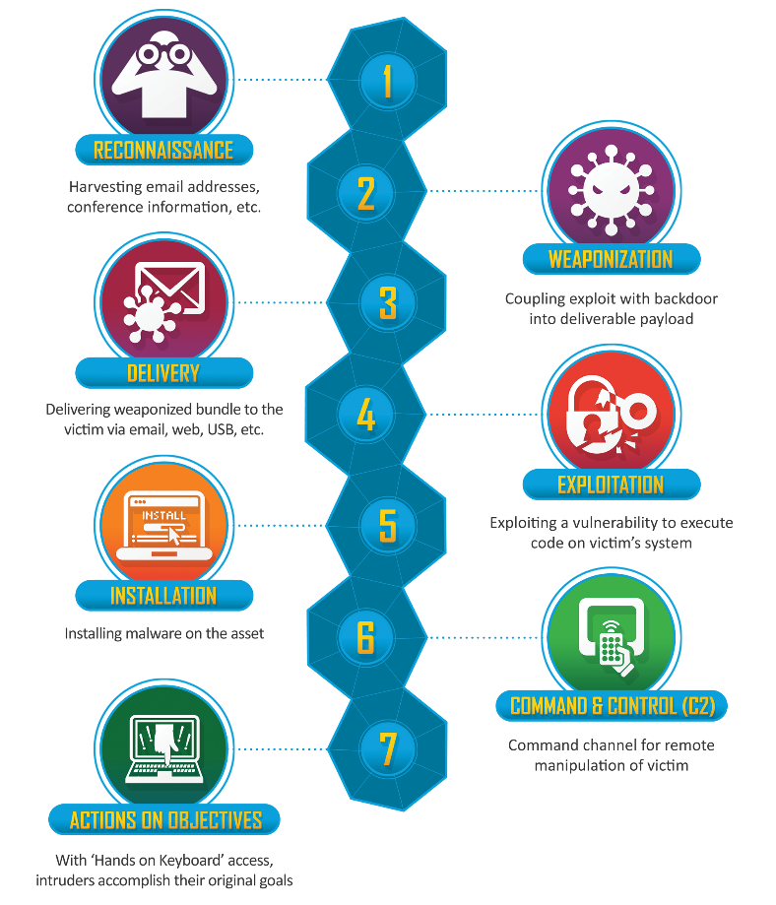
2. Incident Handling 5 – Cyber Kill Chain
© Lockheed Martin
Notes:
External triggers:
In which state is the attacker – what options do we have to defend?
What should be set in place in order to anticipate, to detect, to fast react…
Need to assess each phase of the attack and
* ask yourself: what should we set in place * How can we proof test our organisational, operational, technical and legal set up?
As Incident responders and handlers we have to think like attackers

Slide 16
Section 3 – Incident Management Crisis Management
Crisis is an unexpected threat to your constituency that demands decisions to be taken quickly and out of usual procedures.
Incident response can be a part of the larger crisis management plan.
The ultimate goals of the organisation are to keep essential services running and limit damages.
Crisis will affect:
Roles in incident management
Level of services provided
Who you respond to
Decision making process
Availability of resources
Notes:
Incident management process can be a part of the larger crisis management plan.
An incident can be escalated to a crisis within the organisation (or the country) when the usual procedures are no longer applicable – this can also mean lack of resources, lack of appropriate decision making to mitigate the problem.
During crisis, a crisis management team is usually formed, consisting of people who are in a position to take and enforce immediate decisions in affected areas of business. This may likely include IT and security, PR and communications. The goal is to limit damages (material as well as e.g. to the reputation), and – if possible – keep essential services running. Large enterprises will often have business continuity plans where systems essential to delivering those services are identified along with potential risks and mitigation plans.
During crisis the usual roles and their assignments may be changed, e.g. whole external communication will have to go through one person in the PR department. Everyday services will be affected (e.g. limited or no incident response will be offered to non-crisis related reports). Availability of resources may be decreased or increased.
Discuss with students what crisis management means (or might mean) for their constituency. Note that it will have a different meaning for a university, a large enterprise… or a state – for national CSIRTs. Are they aware of the crisis management plans or business continuity plans that may affect them?
Every city has crisis management, e.g. what when more than 50 people needs to be hospitalized – they have to be distributed to multiple hospitals

Slide 17
Section 1: Introduction to Incident Management Incident Management Models
Various flavors
Observe Orientate Decide Act (OODA loop) → June 1995, John R. Boyd
“Computer Incident Response Guidebook” → US Navy, August 1996
3 best known models
SANS “6-steps Incident Handling” → Early 1990s
NIST SP800-61 “Computer Security Incident Handling Guide”
January 2004, latest update in August 2012 (release v2)
ENISA ”Good Practice Guide for Incident Management” → December 2010
Notes:
Trainer Notes: There are quite a few Incident Handling models.
We will use the ENISA model and give a short overview of the NIST model.

Slide 18
Section 1: Introduction to Incident Management Incident Management Models – OODA Loop
OODA Loop: Observe - Orientate - Decide - Act
Observe
Orientate
OODA Loop
Decide
Act
Notes:
Colonel John Richard Boyd (January 23, 1927 – March 9, 1997) was a United States Air Force fighter pilot and Pentagon consultant of the late 20th century, whose theories have been highly influential in the military, sports, business, and litigation.
Fighter pilot – fulfill the loop within microseconds? – CSIRT: we have more time
Provides overview – very simple process
Comes from military, applies for CSIRT work – feedback loop
18

Slide 19
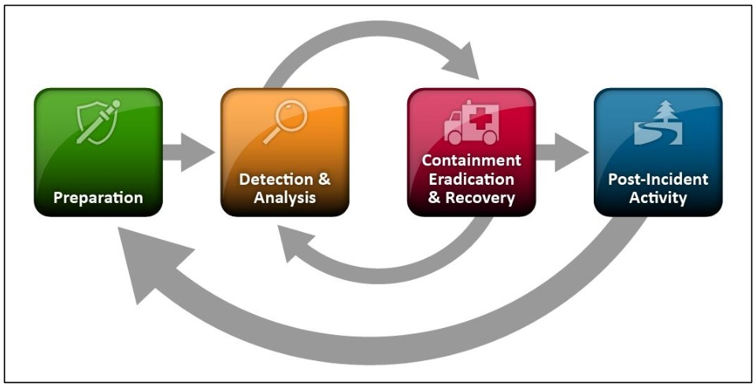
Section 1: Introduction to Incident Management Incident Management Models - NIST
NIST SP 800-61 rev 2 (2012)
© NIST
Notes:
Speaker Notes: Nice example that a incident process is recursive.
You learn from your incidents and feedback to improve your process and security
NIST
National Institute of Standards and Technology
19

Slide 20
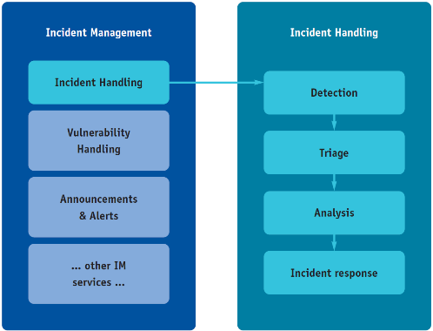
Section 1 – Introduction to Incident Management Incident Management models – ENISA Model
ENISA Model for Incident Management
© ENISA
Notes:
ENISA model for incident management
Incident handling is only one aspect of many …

Slide 21
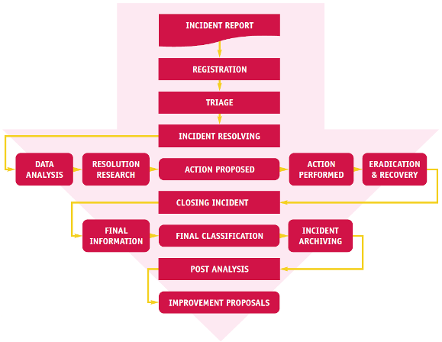
Section 1: Introduction to Incident Management Incident Management Models – ENISA Good practice guide
ENISA “Good Practice Guide for Incident Management” (p.34)
© ENISA
Notes:
ENISA model for incident Handling
This is more detailed than the NIST model, however the flow and idea is more or less the same.
In the ENISA Guide Preparation is being mentioned, but we will discuss this later during Incident Management.
Baby steps, very detailed – but each step can be very small
21

Slide 22

Content: Section 1 Summary
Understand Incident handlers' work
Know your team
Know your perimeter
Know the processes
3 Stages
Preparation → be ready
Run → follow the rules
Capitalize → improve the preparation and process(es) – get faster
Notes:
Be prepared, be faster to resolve the tasks
Operations will run smoother, incidents will be resolved faster

Slide 23
Section 2: Incident Handling
ENISA Approach
Olivier Caleff, Sven Gabriel, Przemyslaw Jaroszewski, Andreas Muehlemann, Roeland Reijers, Marius Urkis
_
_

Slide 24
Content: Part 2 Delivery
Purpose: to pass on knowledge
Important: checking understanding
Important: pace
Important: examples
Important: time for questions

Slide 25
Section 2: Incident Handling ENISA Workflow Overview
Notes:
Speaker Notes: Highlight every step of the process.
ENISA “Good Practice Guide for Incident Management” (p.34)
From data analysis to Eradication and recovery is a recursive process
25

Slide 26


Section 2: Incident Management Models – ENISA
1 – Incident Report
Group exercise:
You arrive at the office and are responsible for the tickets. This is what you find …
What do you do?
What are your next steps?
Incident Report
Photos by Nathan Dumlao and Neonbrand on Unsplash
Notes:
5 example tickets (#1 - #5)
Main steps: registration and triage

Slide 27
Section 2: Incident Management Models – ENISA
1 – Incident Report
Initial input
Issue/problem/incident received by the CSIRT
Must offer multiple way to reach the CSIRT, in case of outages, attacks...
Aim:
Getting the best at first
Aggregating data fast
Keep it easy for the submitters, read “simple emails”
Incident Report
Notes:
How the incident information can arrive on your desk.
Incident notification
E-mail
Fax
Phone
Website form
Automated reporting
Lists
Honeypots …
Newspaper

Slide 28
Section 2: Incident Management Models – ENISA
1 – Incident Report
Full automation to input of incident details looks like a dream… but
Needs to find a commonly agreed terminology that fits everyone, every case, every tool...
Needs to work on correlation and notification similarities
Let's evaluate the number of incidents reported on a standard day... and see if it's worth it
What about bursts in case of a wide outage/incident?
Incident Report
Notes:
Web – pastebin scraping
Intel MQ for getting all stuff together.
Share work with other teams in your neighborhood, …
Can ask teams who is using what for aggregation

Slide 29
Section 2: Incident Management Models – ENISA
1 – Incident Report
Feeds from detection
Noise reduction
Integration with ticketing system – set-up a link between the email handling system and incident handling system
Move from a reactive posture (waiting for emails) to a proactive one:
Integrate tools (IDS probes, scanners, feeds, …)
Integrate third-parties to (automatically) report incidents
Integrate information collected on the web (forums, file repository, …)
Incident Report
Notes:
Speaker notes
Log/SIEM System -> raise an alarm – feeds directly the ticketing
Noise Reduction vs. get as many reports as possible
Spam filters
AV filters
Content filters (may remove/block IP addresses, URLs, Domains, …)
Regular users don't use defang

Slide 30
Section 2: Incident Management Models – ENISA
2 – Registration
Registration process easier with an incident report registration form
Define the most useful/required fields
Assign a unique number for tracking
Leave ground for aggregating/merging various tickets dealing with a single incident...
… but what appears to be a single incident at first may turn out to be different cases
Registration
Notes:
Make it easy for Users to reach out to you
Filtering repeatable messages, e.g. from the automatic systems like SpamCop
Use one place to manage incidents
Automate where feasible

Slide 31
Section 2: Incident Management Models – ENISA
2 – Registration
Attacks against a registration system:
Malicious input: as any input system, all input must be first evaluated
Flooding
Spamming
Leak
Set up some anomaly detection mechanisms and initial filtering for tagging the registered incident
Some tasks cannot be automated: takes time, and human resources
Registration
Notes:
Do you monitor your entry point? What when an attacker attacks a system AND your registration system?

Slide 32
Section 2: Incident Management Models – ENISA
3 – Triage
Triage comes from a French medical term
When confronted with a massive arrival of victims, with only a few medical resources
You need a way to handle all cases in the best way
In a limited amount of time
Solution:
Take into account, diagnose, cure
E.g. set priorities according to formal criteria such as severity of the wounds
Triage
Notes:
To make a good incident evaluation (triage) you should consider a severity of the incident – is it very dengerous (e.g. DDoS attacks) or e.g. a host is infected for long time already. Then you should check how much it's related to your constituency – e.g. you have some service level agreements with some customers – it means – they are the most imoportant for you. An incident also can be in its developing phase so time constrains are very important as well.
Triage (medical term) is the process of determining the priority of patients' treatments based on the severity of their condition. This rations patient treatment efficiently when resources are insufficient for all to be treated immediately.
In our case it is the process of determining which incidents have higher priority and have to be dealt with first.

Slide 33

Section 2: Incident Management Models – ENISA
3 – Triage
Incident Handling has 4 Steps
Verification
Initial Classification
Assign severity and priority
Assignment to an incident handler
Triage
Photo by Erika Giraud on Unsplash
Notes:
Severity and Priority is a first guess, might/will change later
Assignment is also a first guess, ofthen who is now available, might change over time

Slide 34
Section 2: Incident Management Models – ENISA
3 – Triage
Verification
Is it out of scope / out of perimeter
Usually many messages about scan complaints, virus attacks
Other uninteresting cases
Messages written in a foreign or cryptic alphabet
Event not considered an incident by CSIRT standards
Component is not part of the CSIRT constituency
Dubious source of the notification
What is the policy for notification of no interest?
Are you ready to send an ACK?
Do you need additional details?
Triage
Notes:
Can be done by the IR on duty or the assigned person
Do you need more details? ASK!!! Don't try to solve a riddle, you're not the Oracle from Delphi

Slide 35
Section 2: Incident Management Models – ENISA
3 – Triage
Incident Initial Classification / Severity Assessment
Aim to fit into the CSIRT classification scheme with rating, based on the CSIRT role for its constituencies
The more details to help classify, the better
The Initial classification may not be the right one
Additional details may suggest to change classification
Possible to send an ACK to the notification reporter
Ticket number
Hints on the following steps
Prioritization
Dealing with the most severe cases first
Triage
Notes:
What is ”severe” in an IT environment? Depends on your Organization/Environment, see next slide

Slide 36
Section 2: Incident Management Models – ENISA
3 – Triage
Incident initial classification / severity assessment / prioritization
Some criteria for prioritization
Security requirements of the target
Business impact
Type of attacks
Strength of the attacks
Standalone attack or multiple attacks
SLA with the constituency
Criteria may vary depending on the CSIRTs role and activities
Gov CSIRT versus commercial CSIRT
Internal CSIRT versus product-oriented CSIRT
Classification will decide on the amount of effort that will be allocated to the handling of the incident
Triage
Notes:
Possible criteria for prioritization:
Security requirements (Electricity, Transport, …) Impact if anything goes wrong
Business impact
… possible damage

Slide 37
Section 2: Incident Management Models – ENISA 3 – Triage
Incident Assignment
Once the classification is done and the type of effort can be estimated …
The Ticket can be assigned to an Incident Handler
Criteria for assignment
Expertise or capabilities, Resource availability
Knowledge, Language
Roles and tasks
Incident Handler / Manager
Communication / Organization (Incident reporter / Management / Peers)
Analyst(s)
Who decides if a system can be shut down and when?
Move to a 'war-room'?
Checklists: Contact roster, Incident procedure(s)
INCIDENT
HANDLER
INCIDENT
HANDLER
INCIDENT
HANDLER
INCIDENT
HANDLER
VIRUS
SPECIALIST
SPAM
SPECIALIST
PHISHING SPECIALIST
DDoS
SPECIALIST
Notes:
Define roles, split communication and technical tasks
We can propose to shut down a system, but who can decide if it's possible to do so?
Contacts – preparation phase!
Example checklist from SWITCH
War-room, quiet, secured place where you can work and store critical evidence (e.g. forensic data)
37

Slide 38
Section 2: Incident Management Models – ENISA 4 – Incident Resolution
DATA ANALYSIS
RESOLUTION RESEARCH
ACTION PROPOSED
ACTION PERFORMED
ERADICATION AND RECOVERY
Incident Resolution
?
CYCLE
HOW MANY TIMES
Notes:
6 steps, not a a linear process

Slide 39
Section 2: Incident Management Models – ENISA 4 – Incident Resolution
Analysis of competing hypothesis
Incident Resolution
Hypothesis | Evidence / details / comment | Likely / unlikely
Notes:
To start: brainstorming! What could be the cause?
Prepare Hypothesis on Whiteboard if possible
Whiteboards are good for such work!
Ticket #4, Servers down in Lima Peru, we're working in _
Start by brainstorming, what could be the cause for the reboot?
Possible causes:
Power outage due to storm
Cyber attack
Squirrel triggered an outage

Slide 40
Section 2: Incident Management Models – ENISA 4 – Incident Resolution
Analysis of competing hypothesis
Incident Resolution
Hypothesis | Evidence / details / comments | Likely / unlikely
Power outage due to storm
Cyber attack | Unknown IP in the logs
Squirrel triggered a local power outage
Notes:
Prepare Hypothesis on Whiteboard if possible
Whiteboards are good for such work!
Ticket #4, Servers down in Lima Peru, we're working in _
Possible causes:
Power outage due to storm
Cyber attack, first evidence foreign IP in the logs
Squirrel triggered an outage

Slide 41
Section 2: Incident Management Models – ENISA 4 – Incident Resolution
Analysis of competing hypothesis
Inconsistency?
Sensitivity? How would the hypothesis be impacted if certain key evidence were wrong?
Look for simple information first! Phone call vs. IP Address
Conclusion and evaluation: determine the best hypothesis
Incident Resolution
Hypothesis | Evidence / details / comment | Likely / unlikely
Power outage due to storm | No info in media found | ✘
Cyber attack | Unknown IP in the logs | ✘
Squirrel triggered a local power outage | Local power outage, complete block was down | ✓
Notes:
Use also public available information like media reports. If there was a big storm somewhere, you should find some reports in the media
For local issues, check local resources (colleagues, friends, …)

Slide 42

Section 2: Incident Management Models – ENISA 4 – Incident Resolution
May require to ask for resources outside of the CSIRT
As time goes, additional details will be collected
Other incidents may be related
Additional victims may be discovered
…
Incident Resolution
Photo by Markus Spiske on Unsplash
Notes:
Be prepared for whatever may follow

Slide 43
Section 2: Incident Management Models – ENISA 5 – Data Analysis
Formal process
Needs to be documented
Best if it can be replayed
Never work on real data, always on copies
Select the sources
People/staff, components, data, time range
Build a team
Team manager
Split the work according to
Process steps, expertise, availability, workload
Teams' effort
Proceed according to your plan
Incident Resolution
-
Data Analysis
Notes:
The analysis part of the incident must be documented, best if it can be replayed.
Work according to the plan. Remember the firefighters exercise! ☺
What kind of incident related data you should collect about the incident.
Examples:
MW-Urls, Ssh scans, Rootkit analysis, Mw analysis,
Note on timestamps“ Always quote zone!
Where to get this information – network objects where to find info.
Two factors should be taken into account – how good the technical information is + if it comes from trusted sources.
Level of trust of the sources is very important, good cooperation with others create more trusted data in the future.

Slide 44
Section 2: Incident Management Models – ENISA 5 – Data Analysis
Gather more data
Look for details to support the effort of incident handling
Involves data collection and support from the victims
Readily available data in the notification form, including point of contacts, date, targeted environments
Incident knowledge base
Live data from sensors and monitoring systems
Logs from security components
May discover other victims that are not yet aware of the incident
May deduce the next potential victim
Incident Resolution
-
Data Analysis
Notes:
Where to get more data about the incident?
Which data do we want to see?
Data from sensors, monitoring systems, your peers
May discover more victims
May deduce next potential victims which should be informed ASAP.

Slide 45

Section 2: Incident Management Models – ENISA 5 – Data Analysis
May require to liaise with technical partners
Hosting companies, ISP, content providers
HW/SW suppliers, application vendors
Service providers
May require to liaise with business partners
Partners, sub-contractors
Service providers
May require to liaise with authorities
Law enforcement agencies (LEA)
Airport approach, fast overlook, more and more detailed when reaching the point of interest
Level of positive support depends on good will without preparation
Anticipation
Digging and analyzing down to details versus Adapting the level of analysis
Incident Resolution
-
Data Analysis
Photo by Sebastian Grochowicz on Unsplash
Notes:
What is your position to ask for help and support? Any agreements?
Collaboration with peer CSIRTs?
Any legal mandate?
How can they help you?
Cooperation with other CSIRT teams, law enforcement, ISPs, other players.
Usually difficulties with personal data, in particular regarding who is using the particular IP address if it is outside of your organisation. And sometimes it is even difficult within the organisation.
Most of the time you'll need other to help you (Note: The internet does not stop at the border of your constituency)
About the cooperation with others – mission of cooperation can work more likely than implying your needs.
It is important to show that it is in common interests to share information which helps solving the incidents.
Airport approach – first fast overlook, more detailed while reaching the point of interest

Slide 46
Section 2: Incident Management Models – ENISA 6 – Resolution Research
Review data, analyze and see if it points to a resolution
Recursive process with data analysis
IRM: Information and Records Management
SOPs: Standard Operations Procedures
Be prepared to get more expertise onboard
Usually collection of 20-30% of possible information gives you potentially about 80% of answers
Global research approach with tracks
Independent tracks and researches
Project management, brainstorming, tasks, meetings
Review sessions are very important
Key role of the incident manager
Incident Resolution
-
Resolution Research
Notes:
Usually collection of 20-30% of possible information gives you potentially about 80% of answers. So analysing incident related data do not spend too much time on analysis of additional sources of information. In most cases it will not give you new information and they will cost you a lot of work.
Don't spend too much time on one incident – try to resolve it with reasonable level of details – unless it is a research work, then you don't need 100% information.

Slide 47
Section 2: Incident Management Models – ENISA 7 – Action Proposed
Based on the previous steps, proposal for new directions
Keeping on analyzing
Moving to other components
Aiming at going back in time up to the initial event
Present the next steps to the business managers or decision makers
Proposed actions must be explained according to the audience
Technical, business, legal, human resources, …
Examples:
Looking for the origin of the attack
Stopping versus mitigation an attack
Moving to a backup environment
Incident Resolution
-
Actions Proposed
Notes:
Make sure the audience can understand your propositions
e.g.
technician: we need to add more indexes to the database
Manager: what is an index?
Bad example from NASA: you have one slide to explain …

Slide 48
Section 2: Incident Management Models – ENISA 8 – Actions Performed
Actions can be performed by incident team, responders or subcontracted to third-parties
In all cases, everyone must stick to the plan
Results may influence choices
Check if an action has been performed (correctly)
Document (what has been done and when)
Communicate
Incident Resolution
-
Actions Performed
Notes:
Errors might occur when people are working under stress

Slide 49
Section 2: Incident Management Models – ENISA 9 – Eradication & Recovery
Main goal: getting rid of the incident
Eradication
Recovery
Business restoration
Eradication
No more effects
No risk of new compromise
Recovery
Getting back to the pre-incident context
Business restoration
RTO: recovery time objective
RPO: recovery point objective
Incident Resolution
-
Eradication
& Recovery
Notes:
The recovery time objective (RTO) is the targeted duration of time and a service level within which a business process must be restored after a disaster in order to avoid unacceptable consequences associated with a break in business continuity.
A recovery point objective, or “RPO”, is defined by business continuity planning. It is the maximum targeted period in which data might be lost from an IT service due to a major incident.^{[1]} The RPO gives systems designers a limit to work to. For instance, if the RPO is set to four hours, then in practice, off-site mirrored backups must be continuously maintained – a daily off-site backup on tape will not suffice.

Slide 50
Section 2: Incident Management Models – ENISA 4 – Incident Resolution
Keep an eye on open tickets, updates might change the game
10 seconds for 10 minutes , a principle from the emergency room
Staff is under time pressure
Staff works so quickly that they make errors and compromise safety (or the result)
10-for-10 tries to slow down just a little, take a deep breath and a formal time-out
What is the biggest problem right now?
What is the most dangerous aspect of the problem?
Encourage all team members to raise any further concerns or suggestions for improvement or refinement
Then dive back into work
Incident Resolution
Spend 10 seconds more on data gathering, diagnosing and team planning
and save time and improve safety for the next 10 minutes
Notes:
Don't forget your open tickets … is the Incident handler of the day also part of the incident response team or should he stay outside to keep the hotline in order?
10 seconds for 10 minutes, a principle from the emergency room
(from professional healthcare providers)

Slide 51
Section 2: Incident Management Models – ENISA 10 – Incident Closing
Last but not least, this is the end of the incident
No longer an issue
Who decides the incident is closed?
What are the criteria to do so?
What if there is a legal action?
Were sensors and attack detectors added and/or tuned? Should you keep the current settings or change them?
Incident Closing
Notes:
With new kind of incidents or sophisticated incidents it is good to make summary within the team – what lessons are learned, what could be done more.
E.g. If a new virus is spreading (every day more and more) – what can we do? Perhaps issue a media release? Contact press (via the right channels)?

Slide 52
Section 2: Incident Management Models – ENISA 10 – Incident Closing
An incident is finished for the incident handler, when …
All tasks have been fulfilled
Activities have been documented
The incident ticket is closed with all required details
An incident is finished for the incident manager, when …
The required incident handling tasks have all been done
The incident ticket is not re-opened within a give amount of time
The closure of the ticket can be validated
The artifacts, collected items, logs and documentation have been indexed and secured
Incident Closing

Slide 53
Section 2: Incident Management Models – ENISA 10 – Incident Closing
An incident is finished for the victim, when …
Business is back to usual
The victim
Knows the basic actions to take if ever the same incident (or similar) happens again
Knows for sure who to contact if ever the same incident (or similar) happens again
The victim receives a formal notification of the closure
Incident Closing

Slide 54
Section 2: Incident Management Models – ENISA 10 – Incident Closing
FINAL CLASSIFICATION
FINAL INFORMATION
ARCHIVING
Incident Closing

Slide 55
Section 2: Incident Management Models – ENISA 11 – Final Information
What are the messages to release
Targets, potential and real impacts, current status
Main findings
Summary of the issues encountered and work done
Level of understanding and complexity of the attack
New assessed security level
Recommendations, follow-up steps
Need to adjust to both the audience understanding and to the incident's level of complexity
Who should deliver the message?
The incident manager or the CSIRT leader
Able to use different levels of explanations
Who should support afterward
Incident Closing
-
Final Information
Notes:
Use the appropriate language for your audience
Technicians
Managers
“regular” Users

Slide 56
Section 2: Incident Management Models – ENISA 12 – Final Classification
Final classification may be different from the initial one
Initial: based on elements available at the start
Resolution step: during the action phase, while tackling the issue
Final: global and final understanding of the incident
Classification can be useful to speed up the triage phase
Helps starting in the right direction thanks to additional details
Risk of final classification
Focusing on the classification sub-categories
Instead of spending time on extending the criteria and details that help classify
Incident Closing
-
Final Classification
Notes:
Incident closing – if you change classification at the end of the incident, then all parties should get informed.
Incident classification by CERT, not by a reporter, is more precise. The problem is that it also costs a lot of work, and during the collection of information related to the incident you will change your decision many times. The same incident can be the phishing case at the beginning, then a trojan and a social engineering at the end. Additionally it could be frustrating for your staff and finally can be numbing for your operations. Try to avoid it and decide together with your team a moment when you want to finally decide about the incident classification. Usually – sooner – better.
Discussion: how important the classification is? For what?

Slide 57
Section 2: Incident Management Models – ENISA 13 – Incident Archiving
Archives
Must be easily accessible
If an incident occurs again, easier to follow a path that worked
Access must be secured and confidentiality must be enforced
Archive contain all steps to solve the incident
Any security breach of the archives is an incident it itself!
Built-in function vs. CSIRT dedicated solution vs. Organization-wide solution
Incident Closing
-
Archiving
Notes:
Then incident can be archived, but new incidents can be linked with old ones, therefore it is better if the archive is on an active system rather than in a shelf.

Slide 58
Section 2: Incident Management Models – ENISA 13 – Incident Archiving
Laws apply to data in most countries
Privacy regulations and data processing
Data retention requirement and data processing
Depending on the country, laws might have different flavors
After some times, the data are supposed to be deleted
What is the legal data archiving period?
What if you trace back an APT incident that started years ago?
Incident Closing
-
Archiving
Notes:
What is the common practice? How it is done in your team?

Slide 59

Section 2: Incident Management Models – ENISA 14 – Post Analysis
Post Analysis

Slide 60
Section 2: Incident Management Models – ENISA 14 – Post Analysis
Should only start after the incident is closed
Resistance from IHs:
As it is closed, why waste more time on it?
We did it, so why are you investigating our own activities?
We have other incidents to deal with!
Hummm … you do paper work, we do real work …
Off-line quality versus live incidents
Either wait for some weeks before starting post-analysis
Or have dedicated people follow the incident handling from its start
Or organize regular post-incident analysis and feedback sessions
Post analysis should be performed for all incidents
Should deal with what worked well and what didn't?
What are the lessons learned?
Post Analysis
Notes:
It is a good idea to organise periodical meetings of the incident handling team, for example about summary of 2 weeks work, or to decide which incidents would need an automated answers prepared; or which incidents will be analysed deeper.
It is good to discuss things face to face; the same incidents can be handled differently by different people – discussing and information sharing will be useful for all.
Create white paper exercises from incidents
Did all tools work as expected?
Was the documentation up2date?
Did the checklists work as expected?
What should we change for the next incident?

Slide 61
Section 2: Incident Management Models – ENISA 15 – Final Recommendations
Based on previous post-analysis sessions
What went wrong?
What should have been done to prevent that?
Who may benefit from these improvements?
Internal team directly
Internal team indirectly
External stakeholders
Benefits
Better incident handling process
Easier relationships with CSIRTs and other stakeholders
Final Recommendations
Notes:
Analyse the attack anatomy and learn how to avoid it in the future
Explain the “network mechanism” to e.g. the ISP and what could help them to improve infrastructural security
Share confidential information with trusted CERT community (TI, national)
Use specific cases to establish a good relationship with law enforcement

Slide 62
Section 2: Incident Management Models – ENISA Summary
Purpose: to pass on knowledge
Important: to conclude and provide a clear summary of learning points

Slide 63
Section 3: Incident Management
Real world challenges in Incident Management / Incident Handling
Olivier Caleff, Sven Gabriel, Przemyslaw Jaroszewski, Andreas Muehlemann, Roeland Reijers, Marius Urkis
_
_

Slide 64
Section 3: Real world challenges
Purpose: to pass on knowledge
Important: checking understanding
Important: pace
Important: examples
Important: time for questions

Slide 65
Section 3: Real world challenges CSIRT vs SOC
Information Security Event Management
Monitoring and Detection
Analyzing
Information Security Incident Management
Accepting Reports
Analyzing Incidents
Vulnerability Management
Vulnerability Discovery
Report Intake
Analysis
Situational Awareness
Data Acquisition
Communication
Analysis and Synthesis
Knowledge Transfer
Awareness Building
Training and Education
Exercises
Analyzing Artefacts and Forensic Evidence
Mitigation and Recovery
Coordination
Coordination
Disclosure
Response
Technical and Policy Advisory
CSIRT services
(FIRST.org CSIRT service framework)
SOC services
(SOC-CMM)
Security Monitoring
Security Incident Management
Security Analysis & Forensics
Threat Intelligence
Threat hunting
Vulnerability Management
Log Management
Notes:
There are different understandings and explanations on how is different or similar CSIRT and SOC. Main concept here is: CSIRT focuses activities at Incident Management, SOC concentrates at technical implementation of security event/incident detection. Of course security event detection is relevant for most of the CSIRTs, as much as Incident management for the SOC and you can see CSIRT entities that can be named as SOC, and SOCs which can be seen as CSIRTs. Also not every CSIRT can be a SOC, for example national CSIRT which focuses at incident coordination only.
There are services listed in the slide taken from two methodologies – FIRST CSIRT framework and SOC-CMM. Students can discuss which CSIRT services will not be relevant for SOC and which SOC services relevant or not for the CSIRT.

Slide 66
Section 3: Real world challenges Roles
Incident manager
1st level
Situational
awareness
2nd level
3rd level
Reporting & Supervision
Incident Reports
Threat intelligence
Duty officer
Incident handler
Technical task
Analyst
Incident
News
Incident handler
Analyst
Notes:
We are discussing various roles from the perspective of incident management processes, not the team structure in an organisation. A role is a set of tasks and responsibilities, not a position in the organisation. In smaller teams it is perfectly fine to assign more than one role to a single person. As the team grows, you can think of addressing individual roles, taking into account the required skills.
The role of incident manager is to coordinate handling of the incidents, take strategic decisions, interface between the handlers (and the rest of the team) and the higher management, as well as PR, communication etc. He/she is also responsible for the level of preparedness and resilience of the team: tooling, staffing, support for off-site operations, food for over-the-clock activities…
The role of a duty officer is to collect all incoming information, digest them and make sure they are acted upon. Detected incidents need to be assigned to incident handlers, while other information (open/closed source news, reports, threat intel dashboards etc.) should be analysed and digested into situational awareness report. If resources permit, the role may be split into two roles which require different sets of skills: e.g. triage officer and situational awareness analyst.
An Incident handler (also called incident lead) is responsible for incidents that are assigned to him. He will assign tasks to analysts, build and verify hypothesis, communicate with constituency and other parties at operational level. He will report on the progress of investigation and escalate or resolve the incident.
An Analyst will perform technical tasks, such as forensics, reverse engineering, vulnerability testing etc.

Slide 67
Section 3: Real world challenges Possible additional roles
Triage officer
Communication officer
PR officer
Legal officer
Team Manager
Any others?
Notes:
These are just examples. Create a new role in the process when you can clearly define a set of tasks. Then think who is the most suitable person to take that role.

Slide 68
Section 3: Real world challenges Roles – key takeaways
Not all roles require strong technical skills – communication is essential, too!
Split roles as the number of tasks and the size of the team grow.
People are more motivated and efficient when they do what they are best at.
Notes:
It is great if you have people on your team who are both great at technical challenges and communication. However, this is a rarity.
Observe what distracts people from they can do best and think how to address that with a new role. Examples: reporting, communication with non-technical staff, PR statements…

Slide 69
Section 3: Real world challenges Governance issues
Governance issue #1:
You want to handle the incident, but what does the victim want?
Incident handling may not be key to the victims
Victims may rather wish to restart operation ASAP...
...with the risk of deleting or spoiling artifacts
Business driven criteria & decisions – Management's enforcement
Notes:
Specially important in those cases when incident handling would require making copy of the disk and/or memory.
Stress that these are business driven criteria and management decision would be needed.
69

Slide 70
Section 3: Real world challenges Governance issues
Governance issue #2:
What drives incident handling?
Recovering from the incident and going back to business?
Preventing the incident from spreading any further?
Determining the origin of the incident?
Business driven criteria & decisions – Management's enforcement
Notes:
If never encountered before, your reaction will be different than if you handle the incidents multiple times a month.
70

Slide 71
Section 3: Real world challenges Governance issues
Governance issue #3:
What can be said about the incident?
Keep it under the carpet
(Possibly limited) Notification is compulsory by law or regulation
Share with peers
General public communication
Business driven criteria & decisions – Management's enforcement
Notes:
71

Slide 72
Section 3: Real world challenges Governance issues
Governance issue #4:
Crisis Management
What if there is a crisis, what is the role of the CSIRT
Business driven criteria & decisions – Management's enforcement
Notes:
72

Slide 73
Section 3: Real world challenges Governance issues
Governance issue #5:
Information leakage
What if some press agency announces a public report
right now – or in the coming days – but you still want to investigate / monitor the attacker(s)?
Business driven criteria & decisions – Management's enforcement
Notes:
Example from RUAG Case in Switzerland https://www.govcert.ch/blog/22/technical-report-about-the-ruag-espionage-case
The team wanted to monitor the attacker longer, but a reporter gave them a heads-up, he'll publish a story by the end of the week, the complete operation was stopped
73

Slide 74
Section 3: Real world challenges Preparation
IRM – CERT Generale
SANS – Security Incident Checklists

Slide 75
Section 3: Real world challenges Preparation: NIST approach
Prepare to handle
Communication and Facilities
Hardware/software for analysis
Analysis resources
Mitigation software
Prevention measures
Assessments
System hardening
Network hardening
Prevention systems
Awareness raising
Post incident activity

Slide 76
Section 3: Real world challenges Crisis management
Security incident can grow into major incident or crisis, a situation which poses a threat to the organization's existence
Differences between Incident and Crisis management:
Incident management
Tactical level decisions
More predictable
Actions oriented
Smaller scale
Managed by Incident managers
Focused on operations recovery
Crisis management
Strategic decisions
Uncertain
Communications oriented
Larger scale
Managed by C-level management
Focused on reputation, strategic objective
Notes:
Examples of cyber related crisis situations can be: industrial espionage, major flaws in enterprise infrastructure.
Incident management process should have clearly defined conditions when to start crisis management process
During crisis management process C-level executives (CEO, CFO, board of directors, president, etc.) has to provide input at strategic level.

Slide 77
Section 3: Real world challenges CSIRT role in crisis management
FIRST.org CSIRT Services Framework
Service “Supporting crisis management”
Functions:
Distributing information to constituents
Reporting on cyber security status
Communicating strategic decisions
Notes:
FIRST.org CSIRT Services Framework, Service “Supporting crisis management” defines CSIRT functions:
Distributing information to constituents
Reporting on cyber security status
Communicating strategic decisions
Crisis management could use communication channels established by the CSIRT to communicate with constituents
CSIRT can provide situational awareness to crisis management team, when cyber situation is affected by the crisis, or cyber attacks are either reason or consequence of the crisis.
Crisis can impact service level of CSIRT operations, decision can be taken by crisis management team to postpone regular incident response operations. Such decisions has to be communicated clearly to related parties to avoid loss of trust in the CSIRT or host organization.

Slide 78
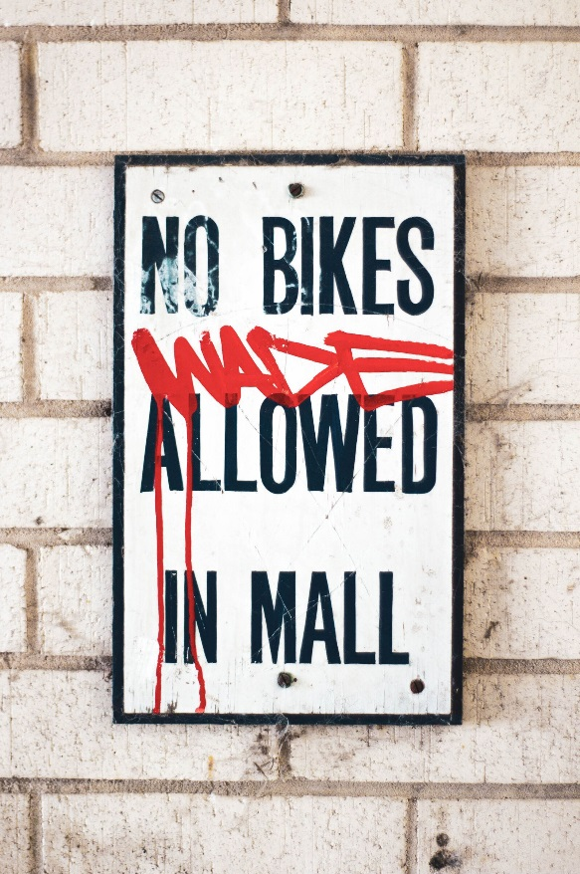
Section 3: Real world challenges Preparation: Set some default rules
Establish ground rules
Never pay for ransomware attack
Always capture the DDOS Guy
Always report to the police
Photo by Joshua Rodriguez on Unsplash
Notes:
Set some rules, make sure management supports them, write them down!
Everyone should know and follow them

Slide 79

Section 3: Real world challenges Resilience
How to keep working when everything falls apart
When not to keep working
Photo by Nadine Shaabana on Unsplash
Notes:
- Police and Firefighters also have rules, when stop working and leave the fire – to save themselves

Slide 80
Section 3: Real world challenges Resilience - How to keep working when everything falls apart
If you are under attack you might not …
be able to use e-mail
be able to use your phone system
How do you communicate?
Think about address books and contacts
PGP keyrings
Access to your tools
If your own tooling is the target?
Notes:
Trainer Notes: Discussion about alternatives. Think about redundant mobile phone providers, other ways to communicate.

Slide 81

Section 3: Real world challenges Resilience - How to keep working when everything falls apart
RFC 1149: A standard for the transmission of IP datagrams on avian carriers
RFC 2549: RFC 1149 with Quality of Service
RFC 6214: RFC 1149 adapted for IPv6
Photo by Kalpesh Patel on Unsplash
Notes:
Trainer Notes: Think about redundant communication channels and device. Be aware of mobile phones, fixed lines telephones and devices might be using the same Network (voice over IP, etc.).
Don't assume different providers (fixe lines, mobile, ISPs etc.) will actually use the same cables and routers.
RFC 1129 was implemented on 28th of April 2001 in Norway

Slide 82
Section 3: Real world challenges Resilience - When not to keep working
Or, how to continue working if the people can't anymore?
Look for signs of burned-out members
Plan for replacements
Prepare a hand-over process
Sometimes resolving incidents takes time; hours, days, weeks.
Hours: Make sure to include breaks and provide food and drinks
Days: Think about replacing members; have replacement ready and up-to-date
Weeks: Set up a rotation schedule
Be prepared you have to force members to stop working.
Notes:
Trainer Notes: You might not know in the beginning that an incident is going to take longer than a working day. Be always prepared that an incident is going to take weeks.
Have a handover process ready and start in time. When people are tired, handovers are going to be messy, too short, and specifics will be forgotten.
Be sure the logging of actions is done properly.
Organize shifts, record working times for each IH
Organize food and drinks
Check everyone is taking a break

Slide 83


Section 3: Real world challenges On-site and off-site Incident Handling
On-site
Local environment with full access to internet resources
If the incident is local or the teams are local
Off-site
When handling incidents on call, working from home
Sometimes, staff must be sent to a remote site
Can be geographically far away, with different time-zones
Need a logistical support
Need standalone components
Need secured communications with the headquarters
Photo by Outside Co and Loic Mermilliod on Unsplash
Notes:
How many teams would go off-site?
You are not in the office – hotel/home
On-site – your office
Most teams are not big enough not to work offsite.
But off-site would be also working at customer's premises. (You know you'll have to work there, you go prepared.)
Who buys the tickets (plane, …), rents a car, hotel, …

Slide 84

Section 3: Real world challenges On-site and off-site Incident Handling
Being able to communicate between team members
Standard case: set-up some VPNs to enter the CSIRT infrastructure
Crisis case: use a dedicated shadow environment
Handle with great care! Not a word about that environment
Preparation
Stand-by environment
Strict rules of usage
Dedicated means of communication
Personal belongings
Photo by Oscar Nilsson on Unsplash
Notes:
Checklists help
Personal belongings: anything that helps YOU!
Headphones
Preferred T-Shirts
Preferred cookies, chocolate

Slide 85
Section 3: Real world challenges On-site and off-site Incident Handling
Use of standalone resources
Internet may not be easily accessible
Local databases and local documentation
Spare disk drives, USB keys, …
Protection of all resources
Time zone issues
Local CSIRT team members must adapt to business hours of the remote team
Reporting to the management must be addressed and adapted
Preparation
Pre-loaded toolkits must be ready
Reusable components
Portable or virtualized environments

Slide 86

Section 3: Real world challenges On-site and off-site Incident Handling
Short-cut and by-pass
Money solve many logistical issues
Power plugs, HW/SW, Internet access
Neither jet-lag nor exhaustion can be solved by money
Second team must be ready to support
Organize work shifts as soon as possible
Spare some time for the staff members' personal life
Prevent from having additional issues
Protect the team and its resources while at rest
Photo by Katie Moum on Unsplash
Notes:
+1 from alpinism:
How are you currently feeling on a scale from 1 to 10?
What do you need right now to get +1 on this scale?

Slide 87
Section 3: Real world challenges Summary
Purpose: to pass on knowledge
Important: to conclude and provide a clear summary of learning points

Slide 88
Section 4: Data Acquisition & Threat Intelligence
Olivier Caleff, Sven Gabriel, Przemyslaw Jaroszewski, Andreas Muehlemann, Roeland Reijers, Marius Urkis
_
_

Slide 89
Section 4 – Data Acquisition & Threat Intelligence
Purpose: to pass on knowledge
Important: checking understanding
Important: pace
Important: examples
Important: time for questions

Slide 90
Section 4 – Data Acquisition & Threat Intelligence Threat Intelligence
Threat intelligence is evidence-based knowledge, including context, mechanisms, indicators, implications and actionable advice, about an existing or emerging menace or hazard to assets that can be used to inform decisions regarding the subject's response to that menace or hazard. (Gartner)
Examples:
Feed of malicious URLs from a popular vendor
Analysis EvilStalker malware
Report on APT-1337 actor's TTPs (tactics, techniques, procedures)
Notes:
TTP: Tactics techniques and Procedures

Slide 91
Section 4 – Data Acquisition & Threat Intelligence Actionable Information
Actionable Information is information that can be examined, expanded, and compared, leading to solid observations and conclusions. It should be relevant, timely, accurate, complete and ingestible. (ENISA)
Examples:
Vulnerability advisory for a product you are using
Anomaly in network traffic
List of IP addresses in your network that looked up a known malicious domain name
Notes:
Relevance relates to the recipient of the information. You are likely to be both (a) the recipient at some times and (b) the producer of information at other times. If you are the producer, one of your responsibilities is to make sure the information is relevant to your recipients.
Timeliness depends largely on the type of information. For example, when you are in the middle of a DoS attack, timeliness is measured in minutes.
For low-level data, you will likely have some automated detection and correlation rules to find suspicious events in your logs. For this type of data, you want processing as close to real-time as possible. As we move through the course, you will see how automation can help in achieving timeliness. And, you will want to continually enhance those automated detection routines.
For data that requires a human analyst, timeliness is a totally different scope. It needs to be recent, but on the order of hours or days. Consider an Advanced Persistent Threat. When this information is received, it cannot be automated but must be assigned to an analyst. In this case, the meaning of 'timely' is vastly different. As you look at the processes and procedures in your organization, remember that one fundamental goal is to reduce turnaround times.
Regarding Accuracy: we cannot stress enough the importance of having all your input and output be accurate. When you are the recipient of information, you are counting on the originator to ensure accuracy. If you are the generator of data, your recipients are counting on you to ensure accuracy. Whenever possible, you will want to reveal both the sources of your data and the method of collection. It is critical that both sides trust the information. If your input is not sufficiently accurate at this point, do not despair as this can be improved as you move through the 5-part process we will discuss in the subsequent modules.
Completeness is related to the particular event. The set of data provided should stand alone. To be most useful it must be immediately actionable by the recipient. You will want to provide as much context as you can to aid the receiver in acting on your information. However, you may have privacy and other legal constraints.
Ingestability refers to how effectively data can be used, especially by data infrastructures. Due to the numerous automated systems, a mountain range of information can be delivered to you. That automated data must be effectively incorporated. In addition, non-automated data must be manageable. Part of your consideration when producing information is the format of delivery.
There will always a tradeoff between timeliness vs. accuracy and completeness.
Source: Actionable information for security incident response (https://www.enisa.europa.eu/publications/actionable-information-for-security)

Slide 92
Section 4 – Data Acquisition & Threat Intelligence Data processing model
low-level data
low-level data
collect
prepare
store
distribute
advisories
advisories
detection indicators
detection indicators
analyze
strategic reports
Notes:
This is the 5-step process for actionable information described in ENISA's whitepaper Actionable information for security incident response (https://www.enisa.europa.eu/publications/actionable-information-for-security). This model is also used thoroughly in FIRST's Fusion course (https://www.first.org/education/trainings#FIRST-Fusion-Course).
The first step is collecting the incoming data. Ideally, it is delivered automatically in a usable format.
After the data is collected it is passed to the preparation phase where data is made consistent (normalized) and, for low-level information, it is combined with similar data, or aggregated.
Next, that prepared data is placed in your security data store.
From that storage, you can not only access that incoming information you were addressing, but also obtain more information to draw new conclusions, the ultimate goal of the analysis phase.
Once analysis is complete, you will want to determine to which of your constituencies and external partners you will distribute. Notice that your distribution can be more low-level information, new or updated detection indicators and advisories, or a new strategic report.

Slide 93
Section 4 – Data Acquisition & Threat Intelligence From acquisition of data to detection of incidents
Threat Intelligence
Actionable Information
1st line of incident handlers + automated systems (SIEM)
Reports from constituency, other CSIRTs etc.
Security-relevant event logs from IT assets
Monitoring, Analysis, Correlation, Visualisation

Slide 94

Section 4 – Data Acquisition & Threat Intelligence Detection
Detecting whether incident happened by:
Manual reporting
Monitoring infrastructure
Proactive gathering of information
Using outcome from other incident analysis
Photo by Nathan Bingle on Unsplash

Slide 95

Section 4 – Data Acquisition & Threat Intelligence Detection - Monitoring infrastructure
Logs
System
Application
Network (netflows, pcaps)
System/network monitoring
Security Infrastructure
Antivirus, DLP, firewalls, WAFs
Any others?
Photo by Thomas Charters on Unsplash

Slide 96

Section 4 – Data Acquisition & Threat Intelligence Detection - Monitoring infrastructure
Sensors
Intrusion detection (network, host)
File integrity checking
Honeypots
Anomaly detection (behavior analytics)
User – Network – System/application
Vulnerability detection (passive/active)
SIEM
SOC
Photo by Helloquence on Unsplash

Slide 97

Section 4 – Data Acquisition & Threat Intelligence Detection – Other sources of information
Proactive gathering of information
Open-source intelligence (OSINT)
Third parties, Cyber Threat Intelligence providers
Media
Blogs, Twitter, …
Outcome from other incidents
Output from forensics analysis
Incident tracking system
Photo by Sara Kurfess on Unsplash

Slide 98

Section 4 – Data Acquisition & Threat Intelligence Summary
Fireman are NOT mighty lonesome gurus who can solve ANY fire, no matter its size, location and “combustible”
Understand that it's a TEAM effort, each and everyone cooperating in reaching ”a” solution → 1 + 1 > 2
Follow the process rather than creating new ways to solve bleeding edge issues → preparation is key
Message of the day:
Don't reinvent the wheel
Follow the rules and operations will run smoother and far better
Photo by Naassom Azevedo on Unsplash

Slide 99
Section 5: Secure Communications (Messaging, PGP & TLP)
Olivier Caleff, Sven Gabriel, Przemyslaw Jaroszewski, Andreas Muehlemann, Roeland Reijers, Marius Urkis
_
_

Slide 100




Section 5 – TLP Traffic Light Protocol
TLP CLEAR Unlimited – no restrictions
TLP GREEN Community-wide, not public
TLP AMBER In-house (organization + clients), need-to-know distribution
TLP AMBER+STRICT In-house (organization ONLY), need-to-know distribution
TLP RED Personal, for named! recipients! only!
More information: https://www.first.org/tlp

Slide 101
Section 5 – Chatham House Rule
When a meeting, or part thereof, is held under the Chatham House Rule, participants are free to use the information received,
but (!)
neither the identity nor the affiliation of the speaker(s), nor that of any other participant, may be revealed.

Slide 102
Section 6: Wrap-up
Olivier Caleff, Sven Gabriel, Przemyslaw Jaroszewski, Andreas Muehlemann, Roeland Reijers, Marius Urkis
_
_

Slide 103
Operational Module
TRANSITS1 Materials
Olivier Caleff, Sven Gabriel, Przemyslaw Jaroszewski, Andreas Muehlemann, Roeland Reijers, Marius Urkis
_
-

